Slide 1

Business Intelligence course
MENDELEY
SMART SUPPLY CHAIN
By Group 006
01
Notes:
Company represents a multi national supply chain system.

Slide 2
Presentation Agenda
Key topics for discussion
01
Introduction to Company
02
Description of Source Data
03
Data Discovery Process
04
Identification of Business Needs
05
Dimensional Model
Notes:
And finally present our dimensional model

Slide 3
Product shipment company in time and cost-efficient manner
Introduction to
Mendeley
Total Revenue in 2017 11 808 436 $
Total Profit in 2017 1 304 085 $
Most products shipped are sports related, however other categories like clothing and electronic supplies are also dispatched. 118 types of products which are divided into 50 categories
03
Notes:
118 types of products which are devided into 50 categories.

Slide 4
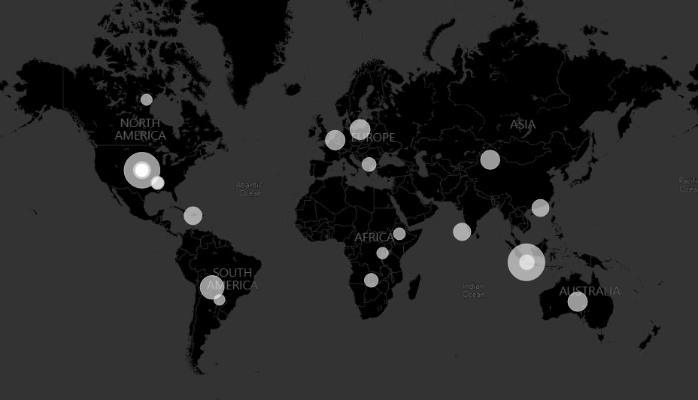
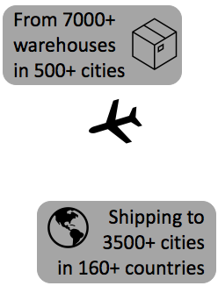

Introduction to
Mendeley
Mendeley ships products to
5 different markets
Latin America (LATAM)
Europe
Pacific Asia
United States & Canada (USCA)
Africa
03
Notes:
And africa

Slide 5

Description of Source Data
Mendeley stores information in three CSV formatted files which consists of
180519 observations and 53 features
29 numeric and 24 categorical
It has data on customers, orders, products and shipping details.
The second dataset has 469 997 observations and 8 features including details on the available products and the third dataset has description of variables.​
The dataset includes transactional records that represent quantifiable facts.

Slide 6

Description of Source Data
Information about transactional data is included in the database for example
Shipping
Profit per order
Sales per customer
Quantities per order
Product discounts
Product prices​
The dataset consists 3 years of
transactional history.​

Slide 7
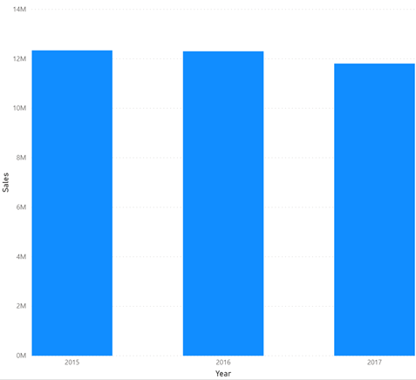

DATA DISCOVERY
Annual sales of Mendeley from 2015 to 2017
In 2015, Mendeley had a revenue of around 12,3 million $
2 years later, this value decreased to around 11,8 million $
In two years lost over 4% in sales
Notes:
Now, we are going to talk about data discovery. The goal for this part was to have an overview of the main insights about the data, to understand possible patterns: on sales, products and customers.
First, let´s discuss sales per year. As you can see on the graph, between 2015 and 2017, sales decreased about four percent. In 2015, Mendeley had a revenue of around 12.3 millions and, 2 years later, this value decreased half a million, to around 11.8 millions.

Slide 8
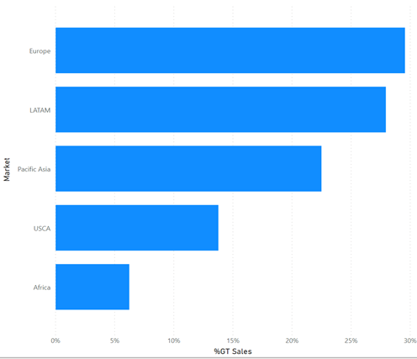
DATA DISCOVERY
Sales per Region
Mendeley is a multi-national company that ships products all over the world (over 164 countries)
Europe and South America represent almost 60% of the market
Notes:
Regarding sales per region, Mendeley ships it´s products to five different markets all over the world mostly, for Europe and south America, which represent almost sixty percent of the total sales.

Slide 9
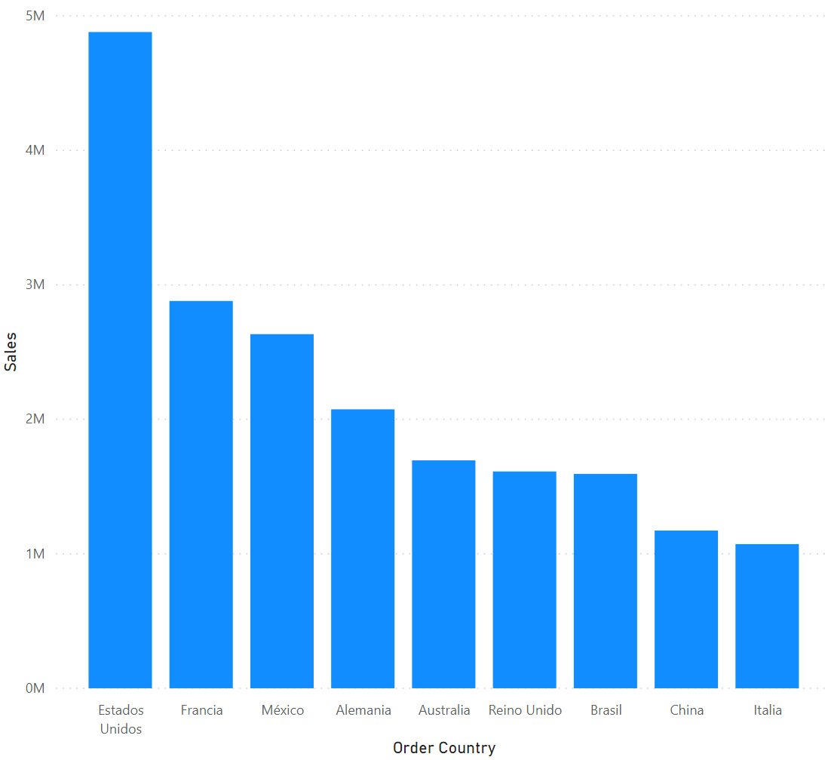
DATA DISCOVERY
Top 10 Countries by revenue
United States is the country with the highest revenue followed by France and Mexico
Notes:
In terms of revenue per country, it is interesting to note that United States buys almost twice as France. Although Europe is the most represented continent with 4 countries on the top 10.

Slide 10
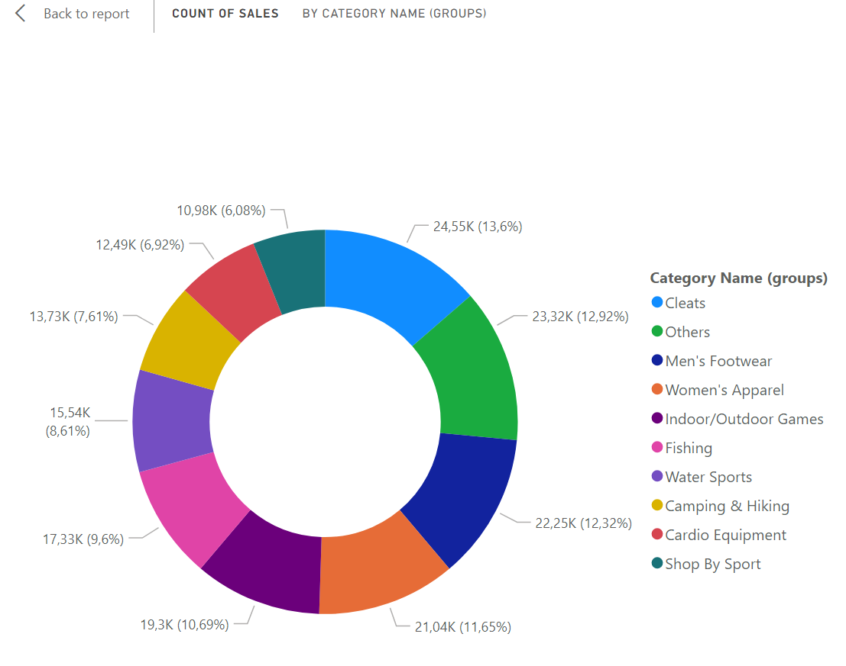
DATA DISCOVERY
Main Categories
Most products shipped are sports related (fishing, water sports, camping & hiking).
However, other categories like clothing and electronic supplies are also dispatched.
Notes:
Regarding the main categories of products shipped, they are mostly sports related, like cleats, fishing and hiking products.
However, our company also ship other kind of products like clothing and electronic products.
In the process of data discovery we have found some potential business problems that we aim to analyse on our project. Let´s discuss them.

Slide 11


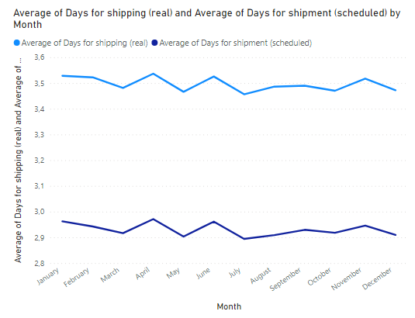
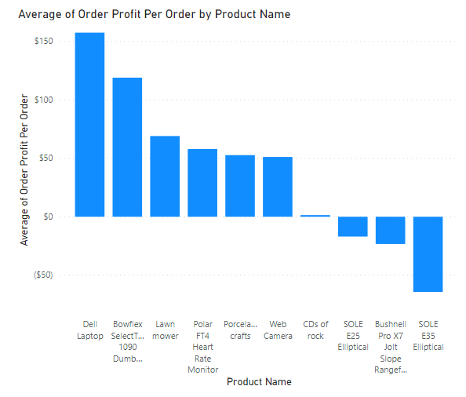

BUSINESS PROBLEM
BUSINESS PROBLEM
SALES
SUPPLY CHAIN
Approximately 60% of the orders arrive later than scheduled
Mendeley is losing money on 20% of the shipped orders
Notes:
Write a sentence commenting the picture with numbers

Slide 12




PERSPECTIVE OF ANALYSIS
SUPPLY CHAIN
SALES
Measure on-time delivery KPI
Average shipment time to each region in the world
What is the key products in term of Product sales?
KPIs on sales – Annually, quarterly, monthly
What is the preferred shipment mode?
Is there any seasonality in the products purchasing patterns?
Where is the key market of the company?

Slide 13
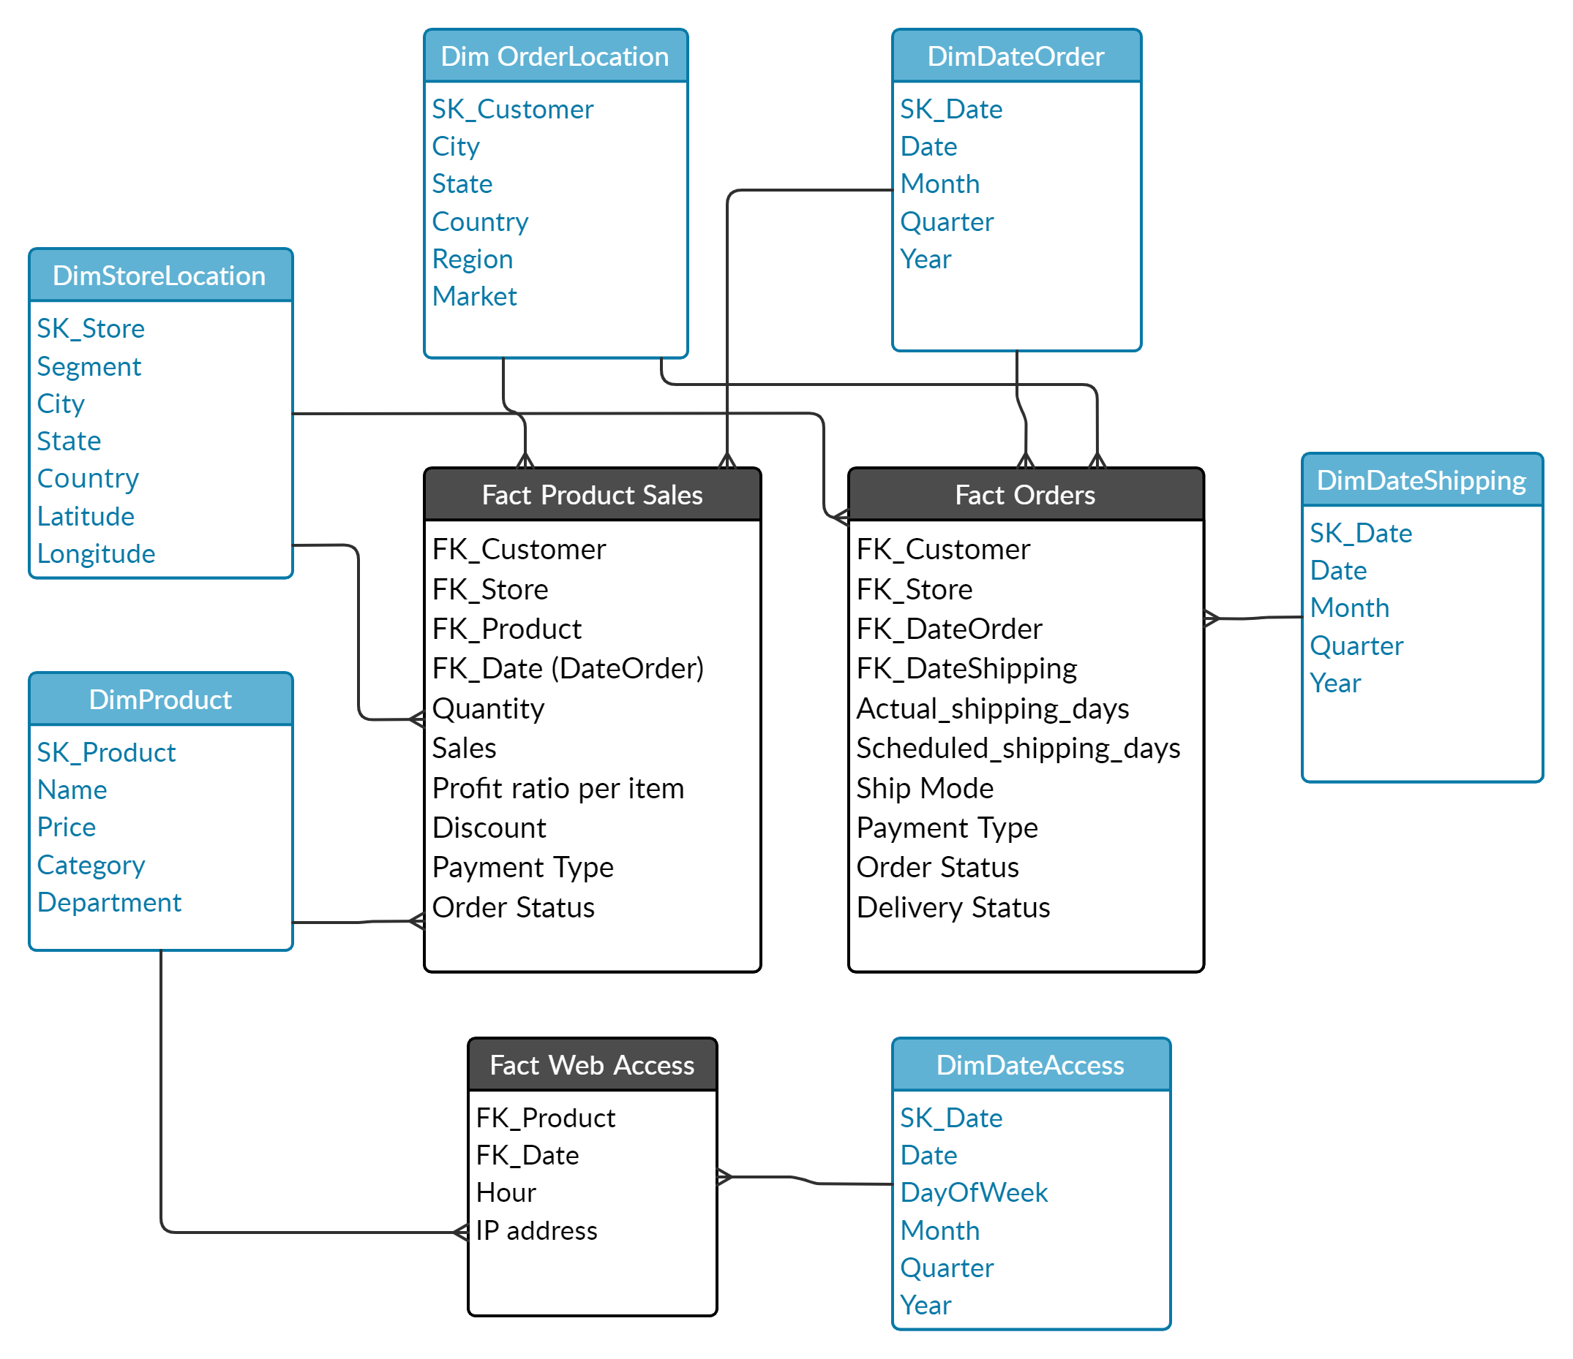







DIMENSIONAL MODEL
Star Schema
3 Fact Tables
1
2
3
Fact Product Sales
Fact Orders
Fact
Web Access Log
6 Dimension Tables
4 Hierarchies
1
2
Product Dimension
Store Location Dimension
Order Location Dimension
Date Dimension
Product
City
City
Date
Category
State
State
Month
Department
Country
Country
Quarter
3
Region
Year
Market
Notes:
We have designed our dimensional model to support the 2 perspectives that were proposed
The model is built in Star Schema.
We have 3 fact tables
The first one is Product Sales. This fact table will focus on the Sales perspective which will included the quantity, total sales, profit and discount of each order item.
The second one is Order Fact. This fact table will focus on the Supply chian perspective which will included the shipping information, order status and delivery status of each order.
The third one is a minor fact table about website traffic. This will have information about the traffic of each product during time of days.
Following the 3 fact tables will be 6 dimension tables covered by Product dimension, Store or warehouse location, Order location, Date of Order, of Shipping and Date for Web access
There are total 4 hierarchies.
Abt product, there are 3 levels which are product, category and deparment
For store location, it will be from City to State to Country
For Order location, there will be from city upto market
The date will be month, quarter and year

Slide 14
Thank you for your time!
Please feel free to ask your questions
10

